Slide 1
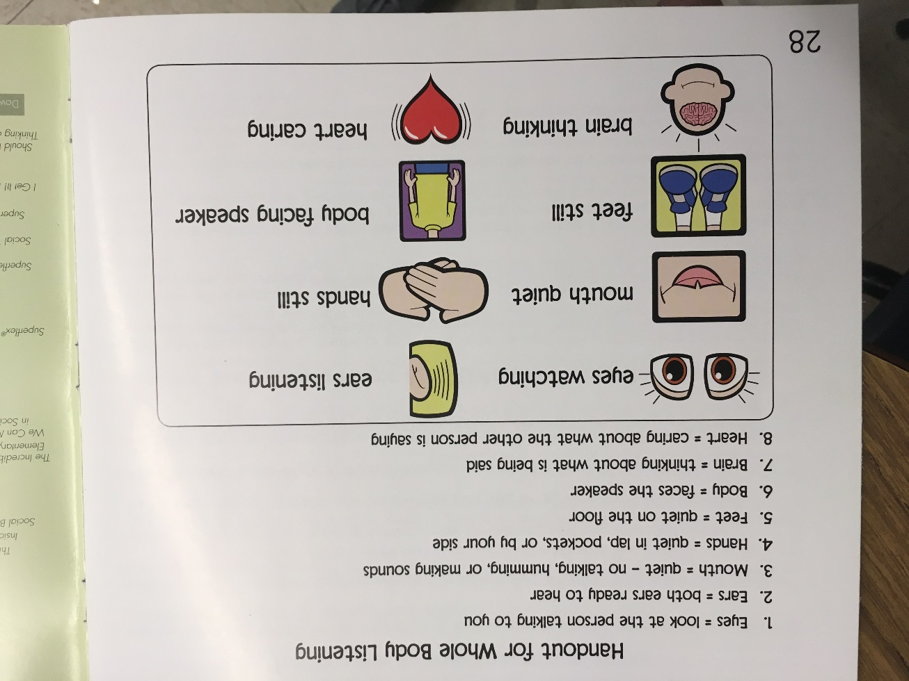
Respect in the Classroom
Whole body listening
What is whole body listening?
Click the picture to the right to see more!

Slide 2
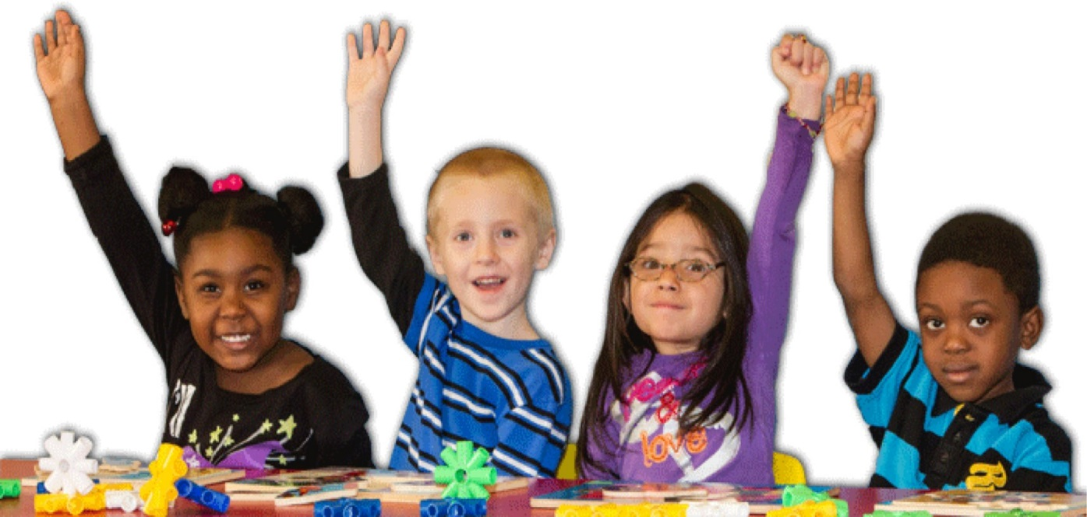
Respect in the Classroom
Raise your hand and wait your turn.
When you have something to add to the conversation, or you need to ask a question you need to raise your hand.
Only one person at a time should be speaking.

Slide 3
Respect in the Classroom
Manners Matter
Use positive language
We all want to feel safe and respected. Use words that pump people up, not to burst their bubble.
"Howard B
and Manners Matter"

Slide 4
Respect in the Classroom
Manners Matter
Always be kind
Choose actions and words that make people feel happy and safe.
Being kind makes others feel good, but it also makes you feel good too!
"Kid President - Things We Should Say More Often"

